Slide 1
A standardized GREGoR data model applied to CMKC Genomic Answers for Kids (GA4K) to augment rare disease discovery by 28,500 genomic datasets generated in 11,000 individuals
GREGoR Science Seminar Series​
Presenters: Craig Smail, Warren Cheung, Cas LeMaster

Slide 2
Goals
GREGoR Data Model on another Dataset
Existing queries on the GREGoR Dataset can be done on any other Dataset with the GREGoR Data Model
Enable Discoveries from the Genomic Answers for Kids Cohort

Slide 3
Overview
Genomics Answers for Kids Project
Collaboration with GREGoR and ANVIL
Implementation

Slide 4
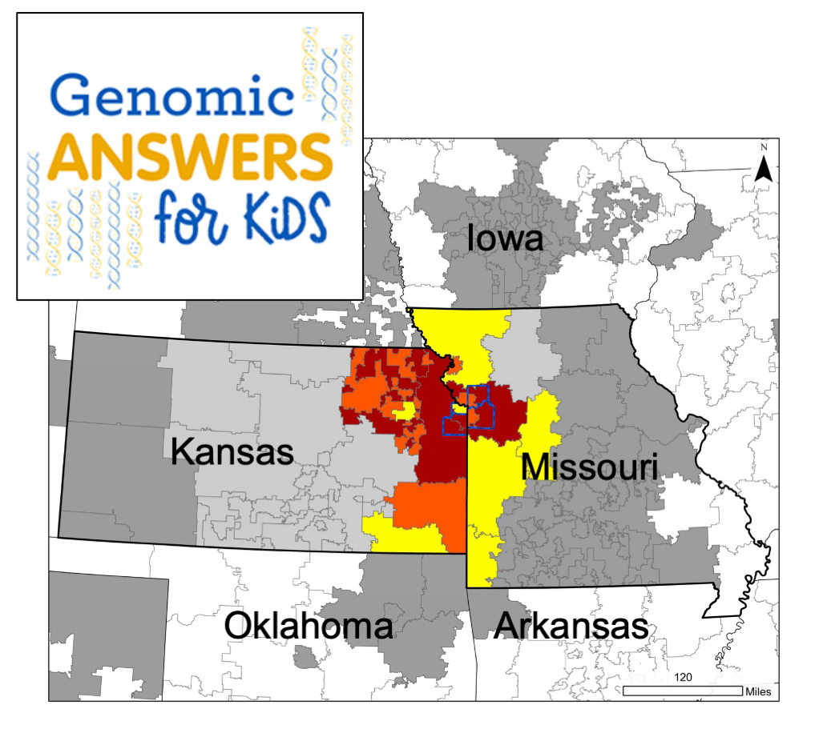
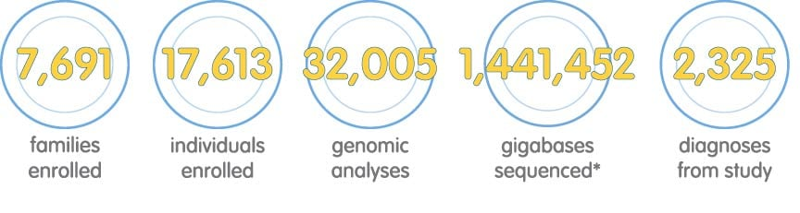
Genomic Answers for Kids (GA4K)
pediatric
rare disease
long read sequencing
trios

Slide 5


GA4K data on ANVIL (v5)
Data snapshot:
2,000 PacBio HiFi long-read WGS
12,000 Illumina short-read WGS or WES
400 patient transcriptomes and epigenomes in individual cells using scRNA and scATAC multiome capture
Individuals in v5: 9,900
Samples in v5: 16,900
Notes:
sequel 2 , Revio

Slide 6
GA4K data on ANVIL (v5)
Data snapshot:
2,000 PacBio HiFi long-read WGS
12,000 Illumina short-read WGS or WES
400 patient transcriptomes and epigenomes in individual cells using scRNA and scATAC multiome capture
Individuals in v5: 9,900
Samples in v5: 16,900
Individuals in v6: ~13,000
Samples in v6: ~22,000

Slide 7
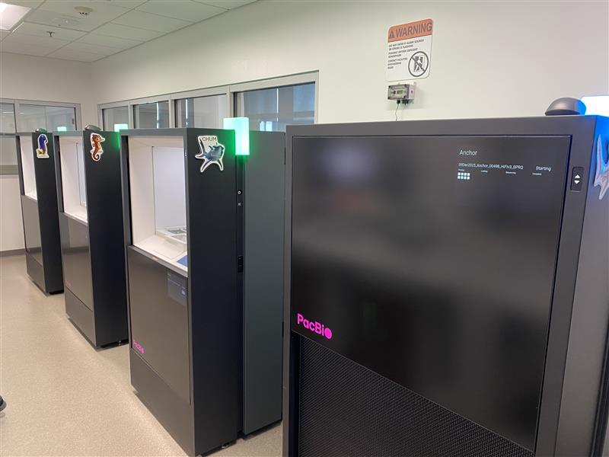

Long-read sequencing focus in GA4K
First center globally to launch HiFi-WGS as “all in one” clinical test
Currently > 3,500 long read genomes sequenced at CMH
reprocessed subset of 1017 PacBio HiFi WGS (v5 release) from full trios

Slide 8
Establishing Connections
Planned out with Kate Balaconis (AnViL) and Ben Heavner (GREGoR)
AnViL hosted GA4K dataset accessed by GREGoR Data Model
Originally aimed to integrate GREGoR ~September 2025
Challenges
Version 5 GA4K on AnViL released late September (final version of tables)
Admin approvals were needed for backend communication across datasets
Need both GA4K permissions (patient data) in addition to GREGoR permissions
Transformation of the data for GREGoR ingestion began ~December

Slide 9
The Big Picture
Transformation and Linkage
particpant_id, family_id, sex, affected_status, paternal_id, maternal_id
family_id, consanguinity
particpant_id, term_id
analyte_id, particpant_id, analyte_type
experiment_id, analyte_id, experiment_type, experiment_sample_id
“
“
“
aligned_dna_file (BAM path), md5sum
“
“
“
generated, links alignments and calls
“
“
called_variants_file (VCF path)
“

Slide 10

The Transformation Pipeline
Create Google Cloud account for computation (running validation workflow)
Map source fields to GREGoR schema (as seen on previous slide)
I used the v1.10 model JSON on github to identify required fields and available enumerations if not strings
Generate IDs (primary keys)
Resolve file paths as GCS links (point to stored files)
Fix formatting (booleans, special characters)
Validate (iterative)
Error reports (stderr, stdout, html) in validation will offer insights
Table import from file storage with rows matching?
VCF IDs match participant ID?

Slide 11
Transformation Pitfalls
Entity ID restrictions
Colons in ID (e.g. 5001-01_HP:0000508)
Participant_ID not in first column
Case sensitivity (booleans = TRUE and /= true)
File paths
Ensure paths lead to bucket files
Inconsistent folder structure can make this a laborious step (/WGS/5001-01/ vs /ES/1132619/)
Files missing (referenced but not in bucket)
VCF Sample ID Mismatch
VCF is 5001-01 but table is 5001-01_WGS
Check actual VCF headers, adjust experiment_sample_id
Remove unresolved rows in referenced tables
Example: if you remove a row from aligned_short_read_dna, ensure the same aligned_short_read_dna ID is removed from aligned_short_read_dna_set
Validation workspace errors
Scatter width > 35,000 (if you have many files), set check_md5 = false after the first verification of md5
Tables don’t overwrite? Manually delete them from the workspace
Import won’t work? Check for duplicate primary keys

Slide 12
The GA4K GREGoR Tables
Participant: 11,422 rows
Family: 5,123 rows
Phenotype: 34,054 rows
Analyte: 12,020 rows
Experiment_dna_short_read: 23,700 rows
Aligned_dna_short_read: 14,148 rows
Aligned_dna_short_read_set
Called_variants_dna_short_read: 22,399 rows
Experiment_rna_short_read: 1,388
Aligned_rna_short_read: 822 rows
Aligned_rna_short_read_set
Experiment_pac_bio: 2,648 rows
Aligned_pac_bio: 1,575 rows
Aligned_pac_bio_set
Called_variants_pac_bio: 2,265 rows
Experiment_atac_short_read: 762 rows
Aligned_atac_short_read: 320 rows

Slide 13
Summary of GREGoR-accessible Data
Participants: 11,422
Families: 5,123
Males: 5,842
Females: 5,580
Complete Trios: 2,207
Total HPO: 34,054
Unique HPO: 1,247
Short Read
WGS: 8,500
Exome: 12,000
MGI: 2,100
WGBS: 1,100
Long Read (PacBio)
Aligned: 1,575
Experiments: 2,648
RNA-SEQ
Experiments: 1,388
ATAC-SEQ
Experiments: 762

Slide 14
Example Query: Getting Started
Install Google Cloud SDK
brew install --cask google-cloud-sdk
pip install firecloud
Authenticate
For Cloud
gcloud auth login
And for Python
gcloud auth application-default login
Find your billing account
gcloud projects list
Find the workspaces you want to query
python3 << 'EOF'
import firecloud.api as fapi
workspaces = fapi.list_workspaces().json()
for w in workspaces:
name = w["workspace"]["name"]
if "gregor" in name.lower() or "dcc" in name.lower():
print(f"{w['workspace']['namespace']}/{name}")
EOF

Slide 15
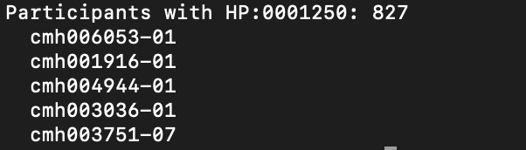
Find Participants with HPO
Set up as before
python3 << 'EOF'
import firecloud.api as fapi
Configure
NAMESPACE = "namespace"
WORKSPACE = "workspace"
HPO = "HP:0001250” (seizures)
Fetch the HPOs
response = fapi.get_entities(NAMESPACE, WORKSPACE, "phenotype")
phenotypes = response.json()
Find who has the HPO
affected = set()
for p in phenotypes:
if p.get("attributes", {}).get("term_id") == HPO:
affected.add(p.get("attributes", {}).get("participant_id"))
Count them and list 5
print(f"Participants with {HPO}: {len(affected)}")
for pid in list(affected)[:5]:
print(f" {pid}")
EOF

Slide 16
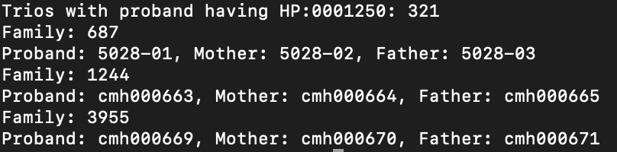
Find Trios with HPO
Continued from previous slide
partis = fapi.get_entities(NAMESPACE, WORKSPACE, "participant").json()
parti_map = {p["name"]: p.get("attributes", {}) for p in partis}
Find complete trios
trios = []
for pid, attrs in parti_map.items():
mat = attrs.get("maternal_id", "0") or "0"
pat = attrs.get("paternal_id", "0") or "0"
if mat != "0" and pat != "0" and mat in parti_map and pat in parti_map:
if pid in affected:
family_id = attrs.get("family_id", "unknown")
trios.append({
"family_id": family_id,
"proband": pid,
"mother": mat,
"father": pat
})
Count and list 3
print(f"Trios with proband having {HPO}: {len(trios)}")
for t in trios[:3]:
print(f"Family: {t['family_id']}")
print(f"Proband: {t['proband']}, Mother: {t['mother']}, Father: {t['father']}")
EOF

Slide 17
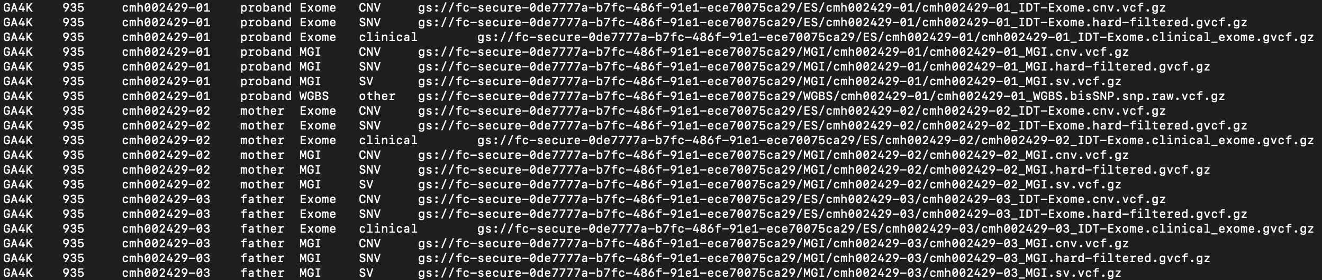
Helpful Example 1
Finding Trio VCF paths using HPO
python find_vcfs_by_hpo_gregor.py HP:0001250 > trio_vcfs.tsv
This script is available @ the Smail Lab github: https://github.com/smail-lab-cmh/gregor-analysis

Slide 18
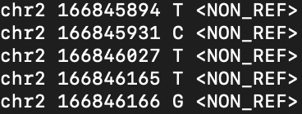
Helpful Example 2
Example: pulling select variants from a specific gene region: SCN1A (epilepsy-related)
BILLING_PROJECT="terra-abc123"
REGION_CHR="chr2"
REGION_START=166845670
REGION_END=166984524
VCF_PATH="gs://your-bucket/path/to/sample.vcf.gz”
gsutil -u $BILLING_PROJECT cat "$VCF_PATH" | zcat |\
awk -v chr="$REGION_CHR" -v start="$REGION_START" -v end="$REGION_END" \
'$1==chr && $2>=start && $2<=end && !/^#/ {print $1, $2, $4, $5}'

Slide 19
Helpful Example 3
Script to compare variants at gene SCN1A for 4 probands with HP:001250
./extract_scn1a_variants.sh
cmh000403_WGS: 2,545 variants
cmh000743_WGS: 1,289 variants
GSS215659-01-011-SG-2: 760 variants
PMGRC-690-690-0_1: 1,235 variants
Total variants: 5,829
Unique positions: 3,995
Common to all 4 samples: 243
Each sample gets a text file with the variant calls
This script is available @ the Smail Lab github: https://github.com/smail-lab-cmh/gregor-analysis

Slide 20
Questions?
Later questions can be emailed to:
Cas LeMaster: clemaster@cmh.edu
Craig Smail: csmail@cmh.edu
Warren Cheung: wacheung@cmh.edu
GREGoR:
Ben Heavner and Stephanie Gogarten
Validation Process
https://docs.google.com/document/d/1-5DmiH9Fn28rx1JMgZSI2shdGlEsni3Ii6qnqcWKWKU/edit?tab=t.0#heading=h.1q39phgouj42

Slide 21




Acknowledgements
AnVIL
Kate Balaconis
GREGoR Data Coordinating Center
Ben Heavner
Stephanie Gogarten
Adrienne Stilp
Terra Support

